Slide 1
Deep Neural Nets - Keras
Tim Smith, PhD

Slide 2
Recall: Deep Neural Networks
Layer 1
Layer 2
Layer 3
Input layer
Output layer
Hidden layers

Slide 3
Keras
High level API
Very easy to use
Uses Tensorflow as the backend library (can also use others)
Keras
Your Python code
Tensorflow

Slide 4
Keras
Keras is now part of Tensorflow
Therefore, you need to install TensorFlow
NOTE: On the tensorflow site it states “Do not install TensorFlow with conda. It may not have the latest stable version.”
On windows, launch anaconda command prompt. On MacOS, launch the terminal application:
conda create –n tf python=3.9
conda activate tf
conda install –c conda-forge tensorflow
pip install tensorflow_datasets

Slide 5
Setting up environment…
conda create –n tf python=3.9
conda activate tf
conda install –c conda-forge tensorflow
pip install tensorflow_datasets
conda install –c conda-forge scikit-learn
pip install scikeras
conda install –c conda-forge pandas
conda install –c conda-forge jupyterlab
Then install anything you need…

Slide 6
Sidenote: TensorFlow
A library for deep learning (developed by Google)
Open source
Very powerful for large scale numerical computations
Can perform parallel computing (both CPU and GPU)
Need to install the GPU drivers for GPU processing
Similar to NumPy (but more powerful)
Helps build custom deep learning models
Build your own neurons
Build your own architecture (skip layers, concatenate layers, etc.)
Build your own training loops, etc.

Slide 7
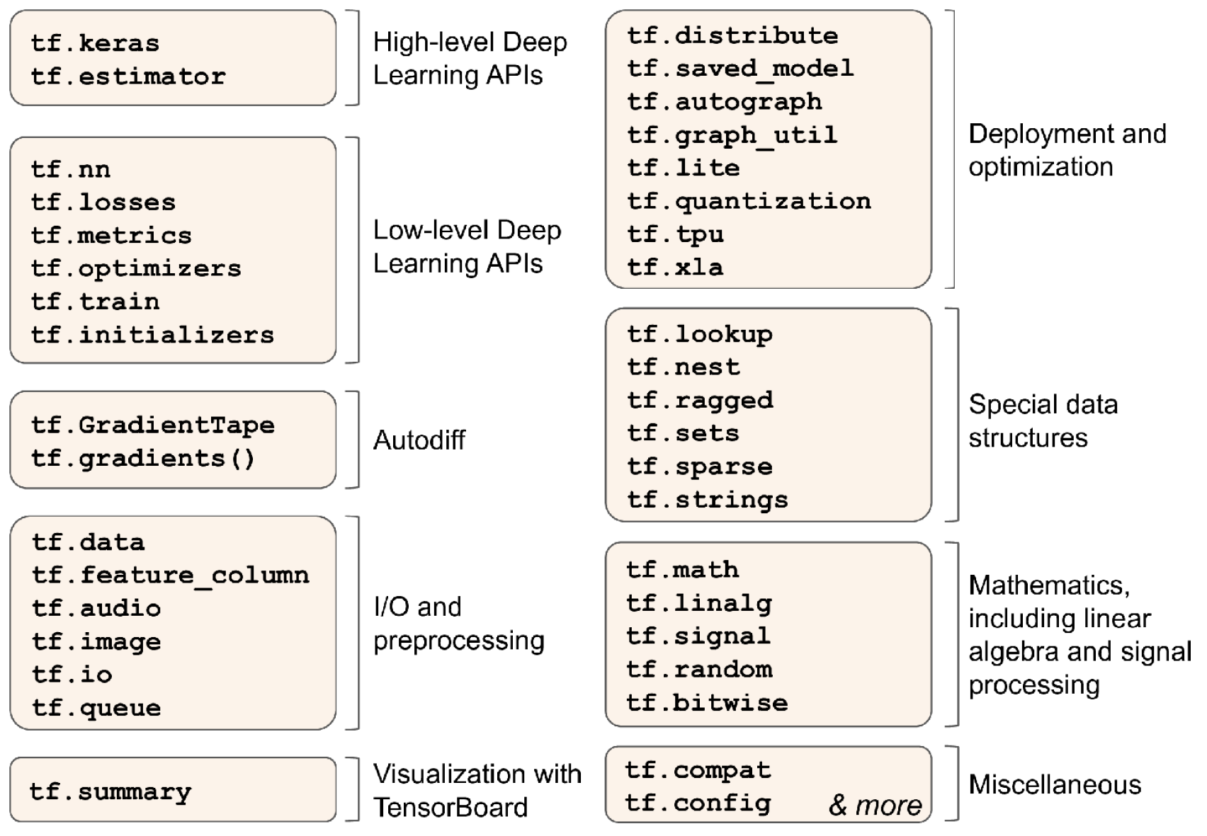
Sidenote: TensorFlow
Python API:

Slide 8
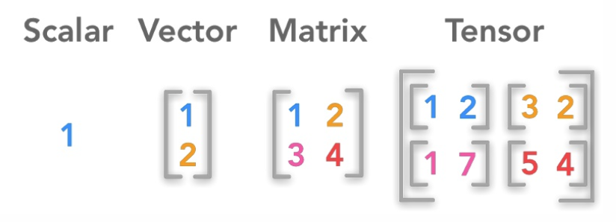
Sidenote: TensorFlow
Tensor: n-dimensional array (like a NumPy array)
Can be created and sliced like a numpy array

Slide 9


Sidenote: TensorFlow
Scalar:
Vector:
tf.constant(42)
tf.constant([1,1,2,3,5,8])

Slide 10
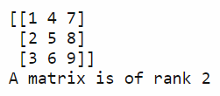
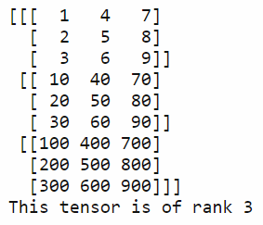
Sidenote: TensorFlow
Matrix:
Tensor:
tf.constant([[1,4,7], [2,5,8], [3,6,9]])
tf.constant([[[1,4,7], [2,5,8],
etc.)

Slide 11
Sidenote: TensorFlow
There are many types of data types:
tf.Tensor (immutable variable)
tf.Variable (mutable variable)
tf.SparseTensor
Etc.
There are many types of operations:
tf.square(tf.Variable([1,2,3]))
tf.add(…)
tf.exp(…)
Etc.

Slide 12
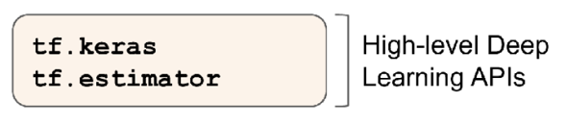
Sidenote: TensorFlow
We will not focus on low-level TensorFlow
We will use high-level APIs (such as Keras)
Keras
Your Python code
Tensorflow

Slide 13
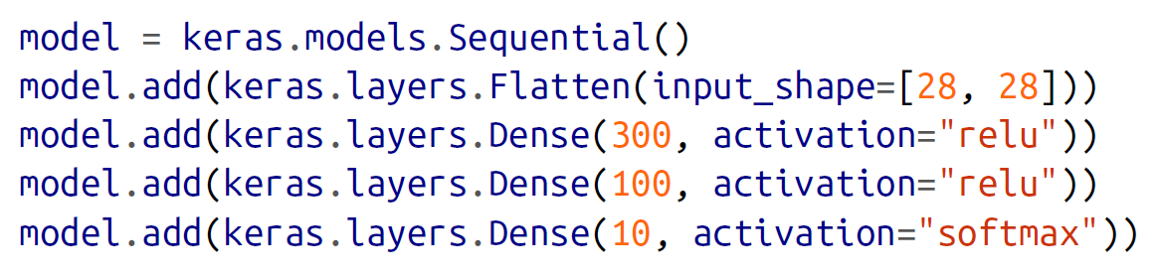
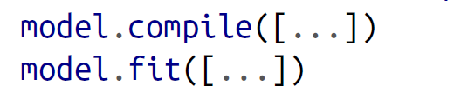
Keras
A simple Keras model:
Input layer
Hidden layer 1
Hidden layer 2
Output layer

Slide 14
Keras – Classification task
Multiclass classification:
Final layer MUST have the same number of neurons as the number of categories
Final layer's activation function MUST BE softmax
Loss function MUST BE sparse_categorical_crossentropy
Binary classification:
Final layer MUST have only ONE neuron
Final layer's activation function MUST BE sigmoid
Loss function MUST BE binary_crossentropy
NOTE: In RARE cases, a multi-class target variable can be one-hot encoded. Then:
Final layer MUST have the same number of neurons as the number of categories
Final layer's activation function MUST BE softmax
Loss function MUST BE categorical_crossentropy

Slide 15
Keras – Regression Task
Regression task: (target is continuous)
Final layer MUST have only ONE neuron
Final layer's activation function MUST BE None
Loss function MUST BE mean_squared_error

Slide 16
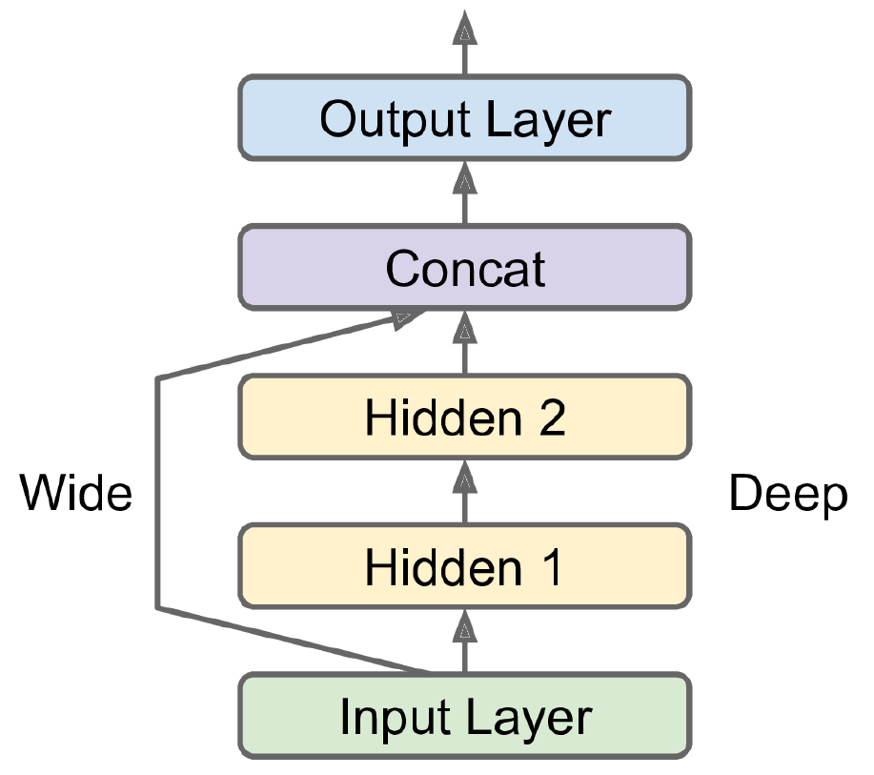
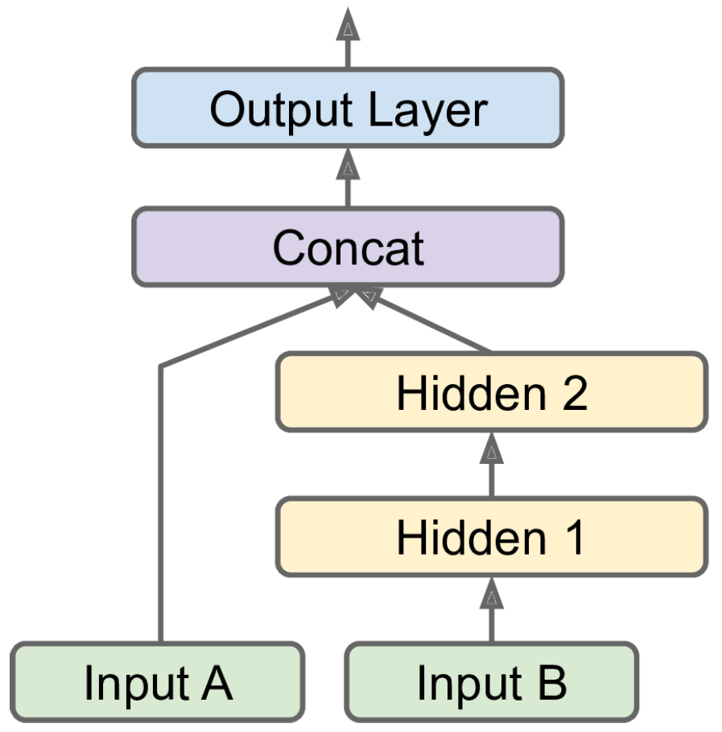
Keras
Keras learns deep patterns
Can it also learn “simple” patterns???
Wide & Deep neural network
Option 1: bypass ALL input variables
Option 2: bypass a subset of input variables

Slide 17
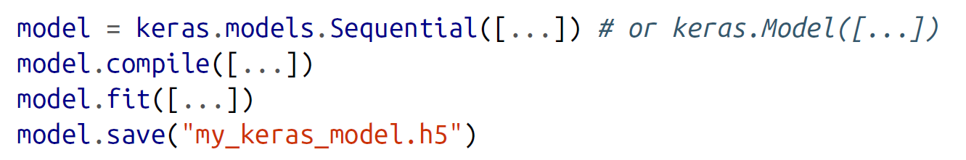
Saving Models
Save models for reusing them later (helps avoid re-training)
Saves:
Model architecture
Every layer’s parameters (weights and biases)
Optimizer

Slide 18
Restoring Models
Restore models
If training takes hours/days, you can save/restore checkpoints as well

Slide 19
Callbacks
Callbacks are commands that can be executed:
Before/after training
Before/after each epoch
Before/after each batch
Callbacks help:
Save “best” model (after best epoch)
Execute early stopping

Slide 20
Fine-tuning the Hyperparameters
So many parameters to manipulate:
Number of neurons
Number of layers
Activation function
Optimizer
Learning rate
Initialization
Etc.
We can use a SciKeras “wrapper” to conduct grid search!

Slide 21
Fine-tuning Hyperparameters
There are techniques better than full/random grid search
They focus on “areas” that turn out “good”
Hyperopt
Keras tuner
Scikit-optimize
Spearmint
Hyperband
Sklearn-deap

Slide 22
Recommendations
Number of hidden layers:
Start with single layer (simple is sometimes better)
Add layers until there is overfitting
Complex relationships require deeper networks (more layers)

Slide 23
Recommendations
Number of neurons (per hidden layer):
Input and output layers are pre-determined
Most common approach: funnel shape
New approaches:
Pipe shape (performs as well, sometimes better)
Inverse funnel shape (use early stopping or regularization to prevent overfitting)

Slide 24
Recommendations
Learning rate:
Start with very low (10⁻⁵) and increase gradually
Example: multiply by exp(log(10⁶)/500)
Goes from 10⁻⁵ to 10 in 500 iterations
Optimizer:
Select Momentum optimization (or RMSProp or Adam)
Batch size:
Try larger sizes (for better models) if they fit in memory
Make them smaller if the results are unstable

Slide 25
Recommendations
Activation function:
Use ReLU as default.
Last layer depends on the task
Number of iterations:
Keep it high, but keep in mind this will increase training time

